Slide 1
Cryogenic Properties of Materials
J. G. Weisend II

Slide 2
Goals
Describe the issues associated with use of materials at cryogenic temperatures
List suitable and unsuitable materials for use in cryogenic systems
Give the physical explanation behind the variation of some material properties with temperature
Provide pointers to material properties

Slide 3
Issues with Materials at
Cryogenic Temperatures
Material properties change significantly with temperature. These changes must be allowed for in the design.
Many materials are unsuitable for cryogenic use.
Material selection must always be done carefully. Testing may be required.

Slide 4
Material Selection
Some suitable materials for cryogenic use include:
  Austenitic stainless steels e.g. 304, 304L, 316, 321
  Aluminum alloys e.g. 6061, 6063, 1100
  Copper e.g. OFHC, ETP and phosphorous deoxidized
  Brass
  Fiber reinforced plastics such as G –10 and G –11
  Niobium & Titanium (frequently used in superconducting RF systems)
    But becomes brittle at cryogenic temperatures
  Invar (Ni /Fe alloy) useful in making washers due to its lower coefficient of expansion
  Indium (used as an O ring material)
  Kapton and Mylar (used in Multilayer Insulation and as electrical insulation
  Quartz (used in windows)

Slide 5
Material Selection
Unsuitable materials include:
  Martensitic stainless steels Undergoes ductile to brittle transition when cooled down.
  Cast Iron – also becomes brittle
  Carbon steels – also becomes brittle. Sometimes used in 300 K vacuum vessels but care must be taken that breaks in cryogenic lines do not cause the vacuum vessels to cool down and fail.
  Rubber, Teflon and most plastics (important exceptions are Kel-F and UHMW used as seats in cryogenic valves)

Slide 6
Thermal Expansivity
Large amounts of contraction can occur when materials are cooled to cryogenic temperatures.
Points to consider:
  Impact on alignment
  Development of interferences or gaps due to dissimilar materials
  Increased strain and possible failure
  Impact on wiring
  Most contraction occurs above 77 K

Slide 7
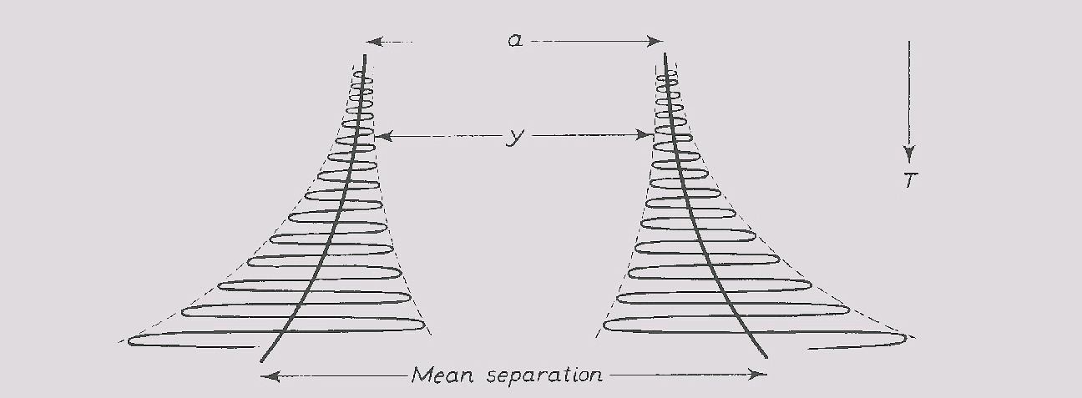
Thermal Expansivity
α=1/L (δL/δT)
Results from anharmonic component in the potential of the lattice vibration

Slide 8
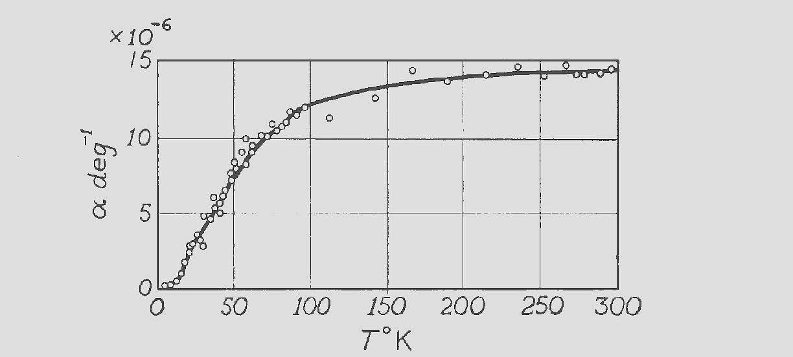
Thermal Expansivity
α goes to 0 at 0 slope as T approaches 0 K
α is T independent at higher temperatures
For practical work the integral thermal contraction is more useful

Slide 9
Integral Thermal Contraction
Material | ΔL / L ( 300 – 100 ) | ΔL / L ( 100 – 4 )
Stainless Steel | 296 x 10 ⁻⁵ | 35 x 10 ^{–5}
Copper | 326 x 10 ⁻⁵ | 44 x 10 ⁻⁵
Aluminum | 415 x 10 ⁻⁵ | 47 x 10 ⁻⁵
Iron | 198 x 10 ⁻⁵ | 18 x 10 ⁻⁵
Invar | 40 x 10 ⁻⁵ | -
Brass | 340 x 10 ^{–5} | 57 x 10 ⁻⁵
Epoxy/ Fiberglass | 279 x 10 ^{–5} | 47 x 10 ⁻⁵
Titanium | 134 x 10 ⁻⁵ | 17 x 10 ⁻⁵

Slide 10
Heat Capacity or
Specific Heat of Solids
C = dU/dT or Q/mDT
In general, at cryogenic temperatures, C decreases rapidly with decreasing temperature.
This has 2 important effects:
  Systems cool down faster as they get colder
  At cryogenic temperatures, small heat leaks may cause large temperature rises
Where is the heat stored ?
  Lattice vibrations
  Electrons (metals)
The explanation of the temperature dependence of the specific heat of solids was an early victory for quantum mechanics

Slide 11
Lattice Contribution
Dulong Petit Law
Energy stored in a 3D oscillator = 3NkT = 3RT
Specific heat = 3R = constant
  Generally OK for T= 300 K or higher
  Doesn’t take into account quantum mechanics

Slide 12
Einstein &
Debye Theories
Einstein explains that atoms may only vibrate at quantized amplitudes. Thus:
This results in a temperature dependent specific heat
Debye theory accounts for the fact that atoms in a solid aren’t independent & only certain frequencies are possible

Slide 13
Debye Theory
The Debye theory gives the lattice specific heat of solids as:
As T ~ 300 K C~ 3R (Dulong Petit)
At T< θ/10 C varies as T ³

Slide 14
Impact of Electrons in Metals on Specific Heat
Thermal energy is also stored in the free electrons in the metal
Quantum theory shows that electrons in a metal can only have certain well defined energies
Only a small fraction of the total electrons can be excited to higher states & participate in the specific heat
It can be shown that C_{e} = γT

Slide 15
Specific Heat of Solids
The total specific heat of metals at low temperatures may be written:
C = AT³ +BT - the contribution of the electrons is only important at < 4 K
Paramagnetic materials and other special materials have anomalous specific heats -always double check

Slide 16
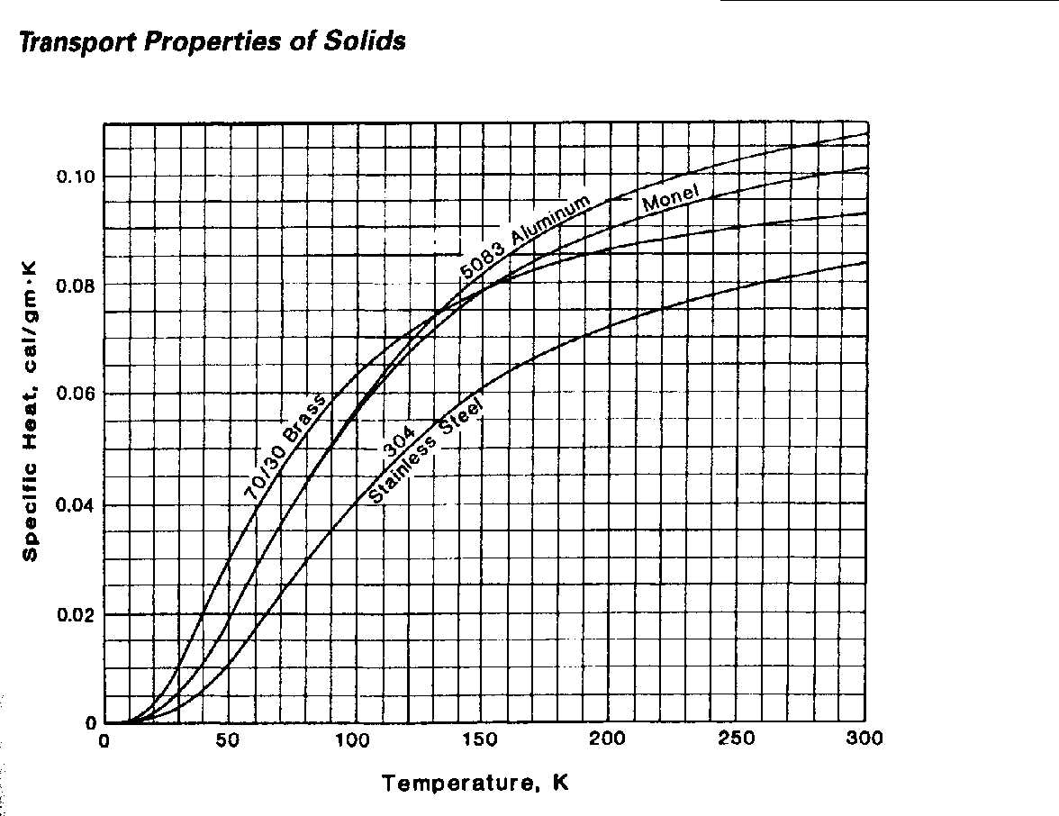
Specific Heat of Common Metals

Slide 17
Thermal Conductivity
Q = -K(T) A(x) dT/dx
K Varies significantly with temperature
Temperature dependence must be considered when calculating heat transfer rates

Slide 18
Thermal Conductivity of Metals
Energy is transferred both by lattice vibrations (phonons) and conduction electrons
In “reasonably pure” metals the contribution of the conduction electrons dominates
There are 2 scattering mechanisms for the conduction electrons:
  Scattering off impurities (W_{o} = β/T)
  Scattering off phonons (W_{i} = αT²)
The total electronic resistivity has the form :
W_{e} = αT² + β/T

Slide 19
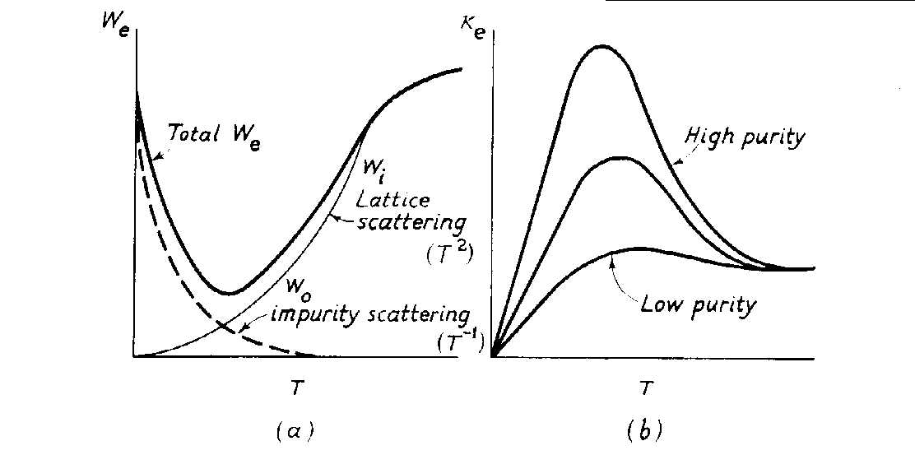
Thermal Conductivity of Metals Due to Electrons
From Low Temperature Solid State Physics –Rosenburg
The total electronic resistivity has the form : W_{e} = aT² + b/T K~ 1/We

Slide 20
Heat Conduction by
Lattice Vibrations in Metals
Another mechanism for heat transfer in metals are lattice vibrations or phonons
The main resistance to this type of heat transfer is scattering of phonons off conduction electrons
This resistance is given by W = A/T²
Phonon heat transfer in metals is generally neglected

Slide 21
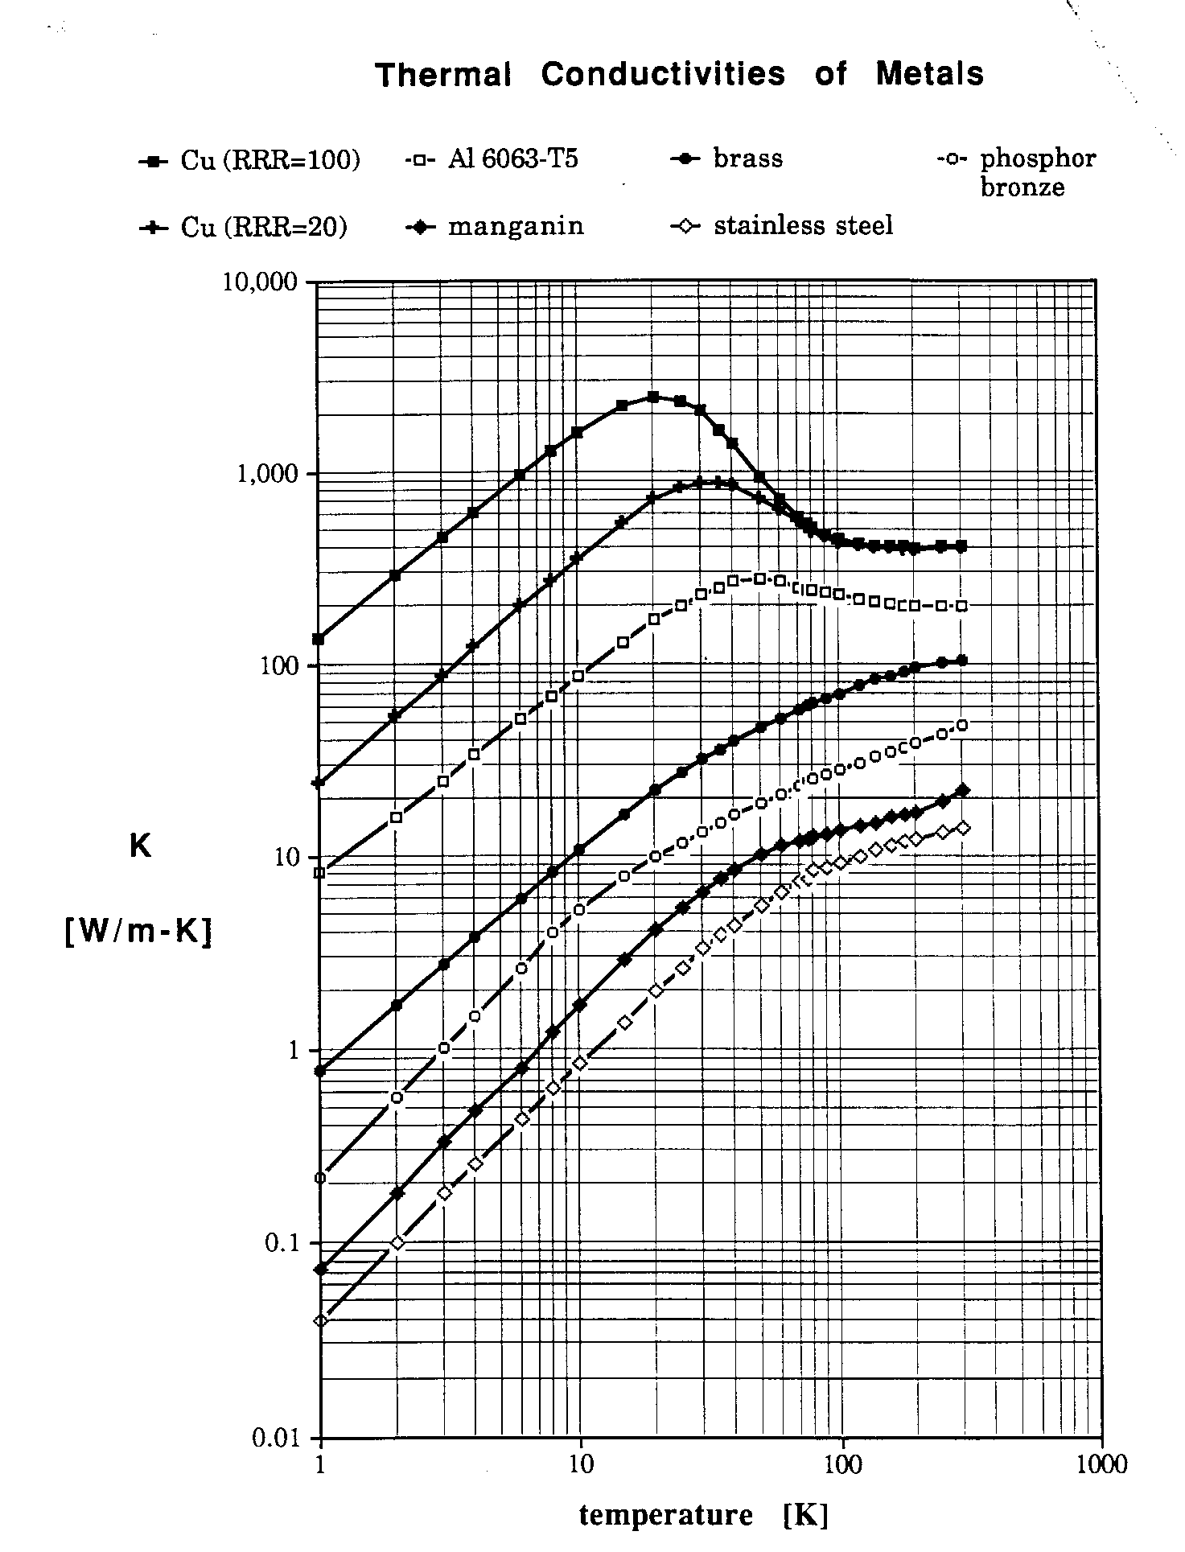
Thermal Conductivities of Metals
From Lakeshore Cryotronics

Slide 22
Thermal Conductivity
Integrals
The strong temperature dependence of K makes heat transfer calculations difficult
The solution is frequently to use thermal conductivity integrals
The heat conduction equation is written as:

Slide 23
Thermal Conductivity
Integrals
G is the geometry factor
θ is the thermal conductivity integral

Slide 24
Thermal Conductivity
Integrals
Advantages:
  Simple
  Only end point temperatures are important. (assuming there are no intermediate heat sinks) The actual temperature distribution is not.
  Thermal conductivity integrals have been calculated for many engineering materials
  This is quite useful for heat leak calculations

Slide 25
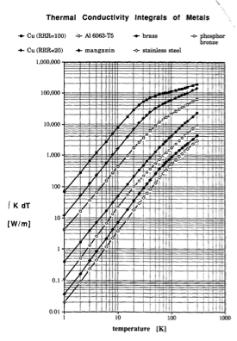
Thermal Conductivity
Integrals of Metals
From Handbook of Cryogenic Engineering, J. Weisend II (Ed)

Slide 26
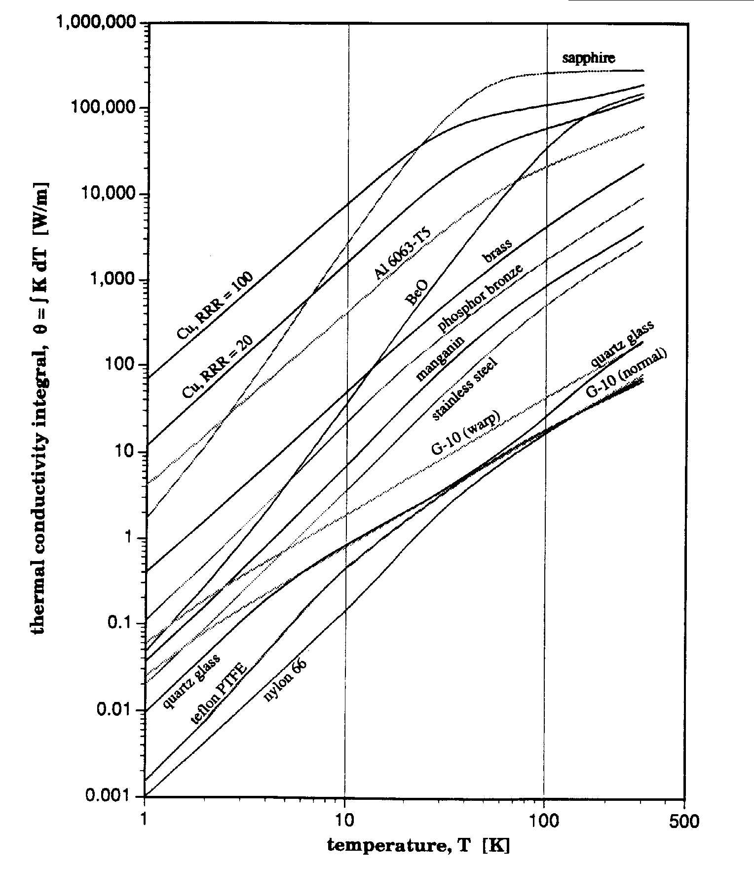
Thermal Conductivity Integrals of
Metals & Nonmetals

Slide 27
Electrical Resistivity
Ohm’s Law V=IR
  R=ρL/A where ρ is the electrical resistivity
Conduction electrons carry the current & there are 2 scattering mechanisms
  Scattering of electrons off phonons
  Scattering of electrons off impurities or defects (e.g. dislocations)

Slide 28
Electrical Resistivity of Metals
For T ~ θ phonon scattering dominates
  ρ is proportional to T
For T<< θ impurity scattering dominates
  ρ is constant
Between these two regions (T~ θ/3)
  ρ is proportional to T⁵ for metals
RRR = ρ (300 K)/ρ (4.2K) an indication of metal purity
Notes:
In the superconducting RF world, a significant amount of effort is expended in trying to produce high RRR Niobium. In general, high RRR materials have better thermal conductivities and this allows for more efficient heat transfer from the inside of the cavity to the helium coolant.

Slide 29
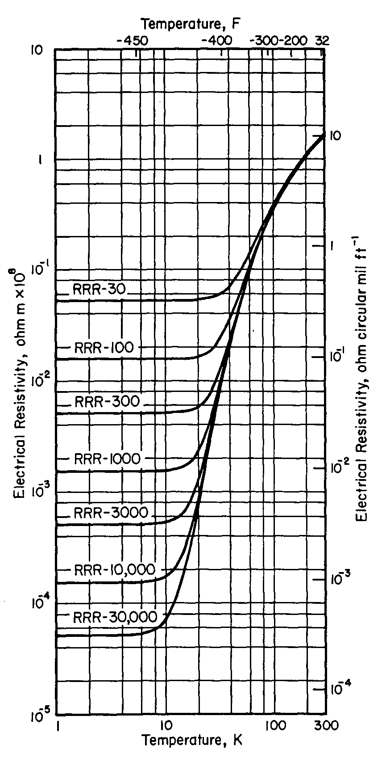
Electrical Resistivity of Copper
Electrical Resistivity of Copper
From Handbook of Materials for Superconducting Machinery (1974)

Slide 30
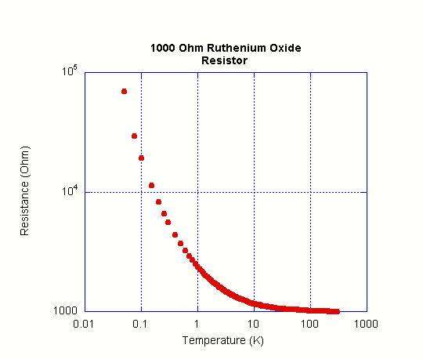
Electrical Resistivity of Other Materials
Amorphous materials & semiconductors have very different resistivity characteristics than metals
The resistivity of semiconductors is very non linear & typically increases with decreasing T due to fewer electrons in the conduction band
Superconductivity – A later lecture

Slide 31
Material Strength
Tends to increase at low temperatures (as long as there is no ductile to brittle transition)
300 K values are typically used for conservative design. Remember all systems start out at 300 K & may unexpectedly return to 300 K.
Always look up values or test materials of interest

Slide 32
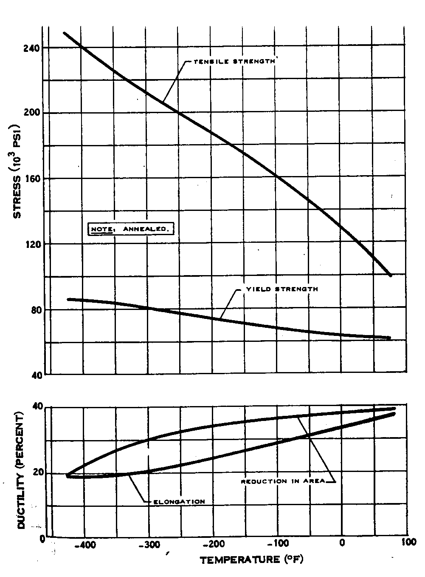
Typical Properties of 304 Stainless Steel
From Cryogenic Materials Data Handbook (Revised)
Schwartzberg et al ( 1970)

Slide 33
Sources of Data for the Cryogenic Properties of Material
“A Reference Guide for Cryogenic Properties of Materials”, Weisend, Flynn, Thompson; SLAC-TN-03-023
Cryogenic Materials Data Handbook: Durham et al. C13.6/3.961 :
MetalPak: computer code produced by CryoData
http://www.htess.com/software.htm
CryoComp: computer Code produced by Eckels Engineering
http://www.eckelsengineering.com/
Proceedings of the International Cryogenic Materials Conferences (ICMC)

